Slide 1
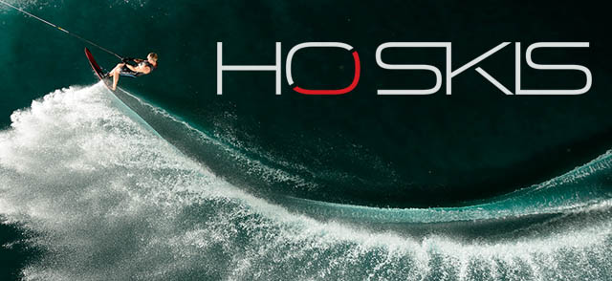
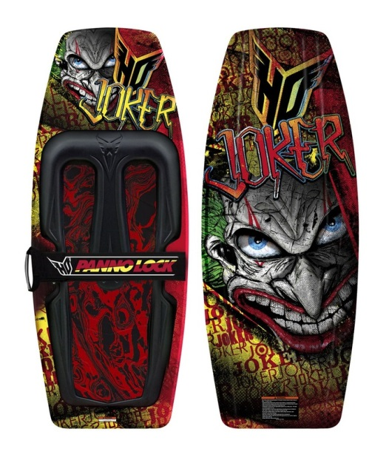
Herb O’Brien
A legend of the water ski.

Slide 2
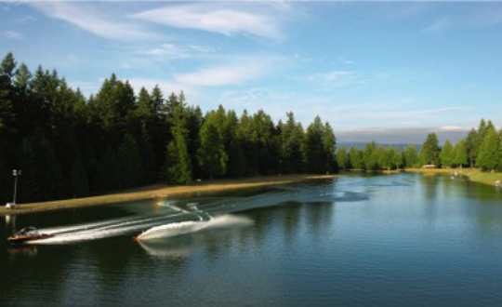
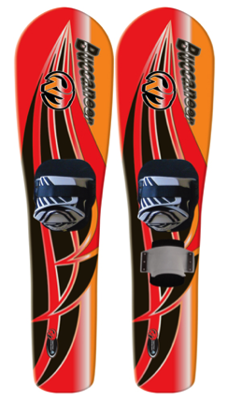
What herb was famous for:
Herb was mostly famous for building one of the first man made lake.
Built in 1972
Radar Lake is located in Woodinville Washington.
Radar Lake is now a ski park in his honour.
Radar Lake is one of the most popular ski parks in the world
Herb was also famous for designing the tunnel bottom ski These double skis are made to make deep water starts effortless. The figurative shaped side cut design makes turning easy. The idea of the Tunnel concave bottom is so that you can have an easy effortless ride, hence the series name ‘easy rider’.

Slide 3
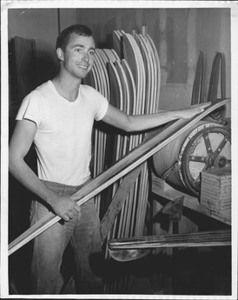
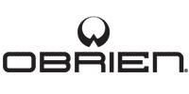
How he got into water skiing and creating the company of O’Brien skis
Herb mostly got his influences from his dad, his dad wasn’t famous he was just a every day water skier and herb said that he wanted to be just like him. Herb came up with the idea of O’Brien skis when he was a boy and he use to watch the few boats go past with skier's on the back, that was when he got the inspiration to start his own company in the basement of his house.

Slide 4
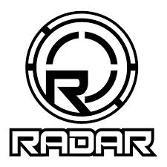
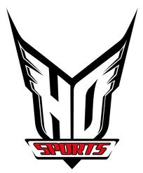
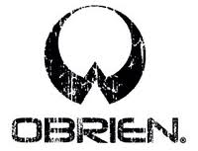
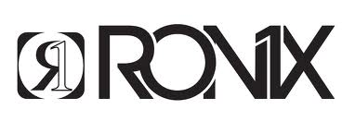
Herb’s companies
O’Brien ski’s
H.O water sports
Hyperlite
Square one (also known as Ronix)
Radar ski’s
- Been in and out of companies.

Slide 5
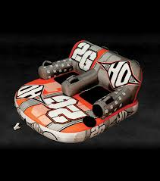
Herb and his role as a designer
Tunnel bottom ski
Companies = bigger range in equipment
Influences
Herb didn't only made serious sport equipment he also made tubes for the people who like thriller rides.
://youtu.be/TNyxgyIZFno

Slide 6
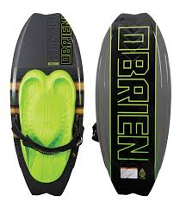
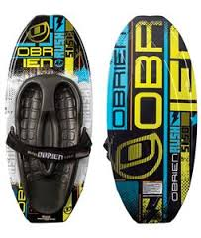
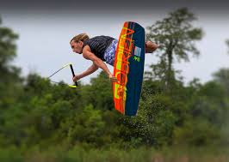
O’Brien kneeboard
The O’Brien kneeboard was made for something different, he wanted to challenge him self to do something completely innovative and different.
http://www.youtube.com/watch?v=F0w3j6RzJIk#t=51

